Slide 1
Negative and Positive Feedback

Slide 2
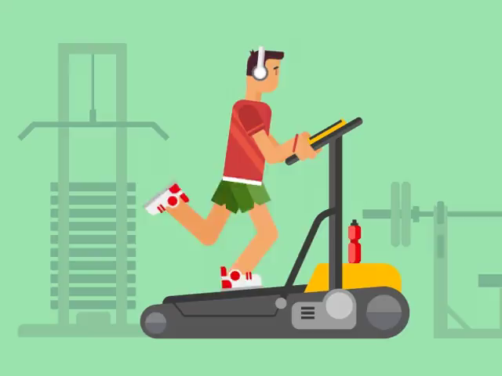
By the end of this lesson you should be able to:
1. Describe negative feedback and provide an example.
2. Describe positive feedback and provide an example.
3. Explain why negative feedback is useful for homeostasis, but positive feedback is not.

Slide 3
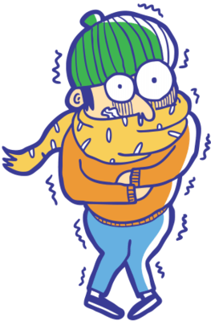
When maintaining homeostasis, the body's response acts against the initial stimulus.
This is called negative feedback.
For instance, on a cold day the body’s temperature might start to cool down. In response, the body will shiver. This produces heat, warming the body back up. In this scenario, the stimulus was the body cooling down. The response opposed this, acting to warm the body up!

Slide 4
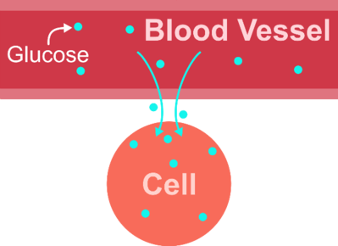
An example of negative feedback is the regulation of blood glucose levels.
If blood glucose concentrations start to rise above normal levels, then the body can tell cells to absorb glucose from the blood. This brings the blood glucose concentrations back down.

Slide 5
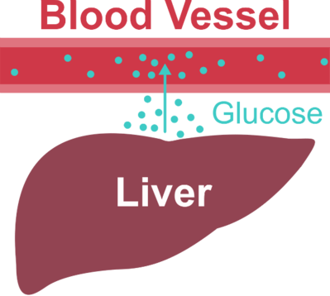
What about when blood glucose levels are too low?
Homeostasis can also work the other way! If blood glucose falls below normal levels, then the liver can excrete glucose into the blood. This brings the blood glucose levels back up.

Slide 6
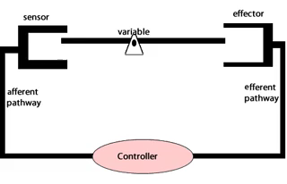
Negative feedback is really useful, because it keeps the body's internal environment stable.
Whenever the environment changes in one direction, the body moves to bring it back to where it was.

Slide 7
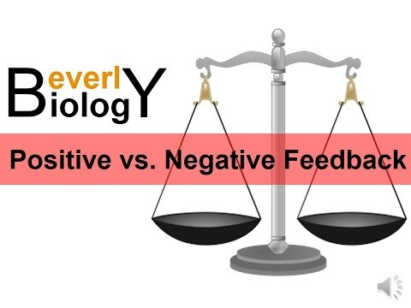

Slide 8
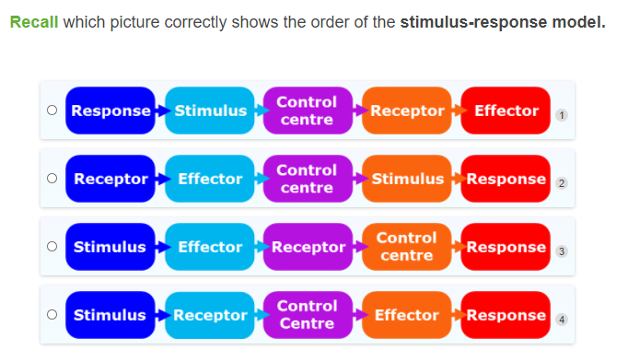

Slide 9
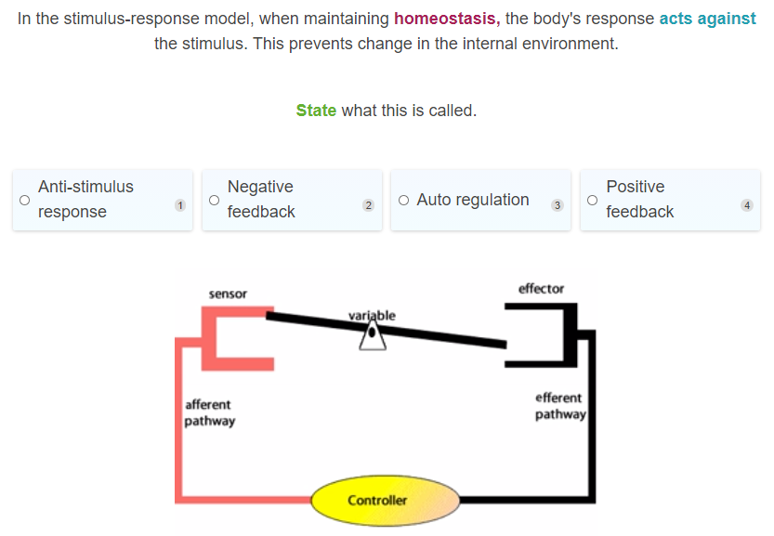

Slide 10
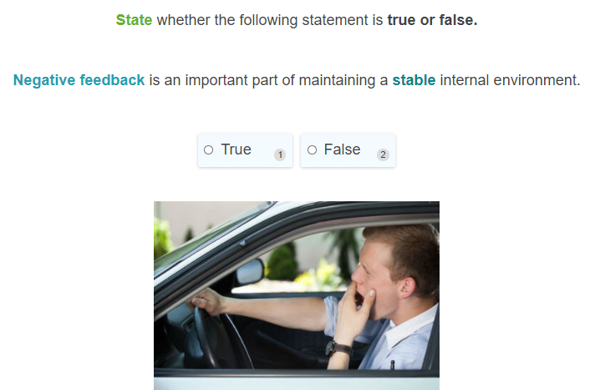

Slide 11
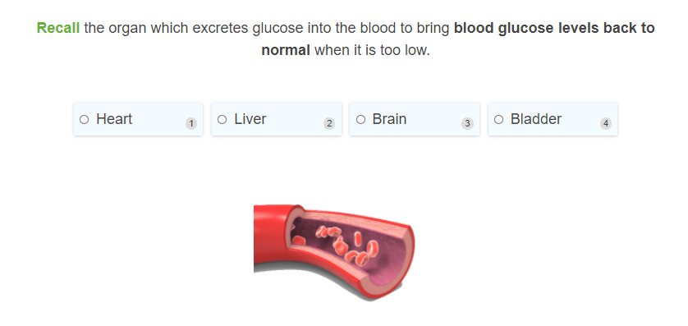

Slide 12
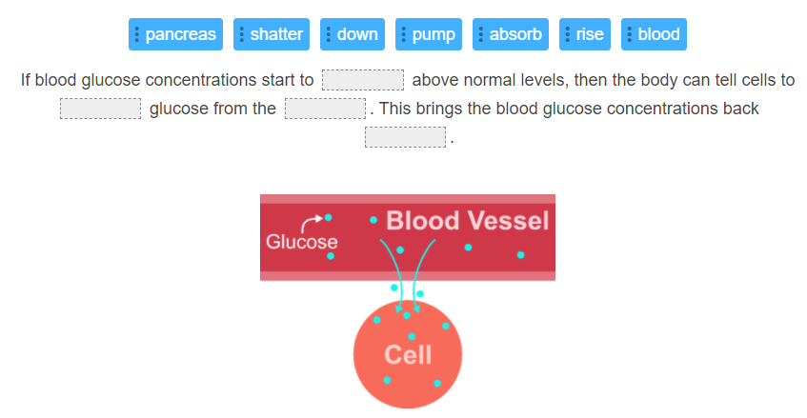

Slide 13
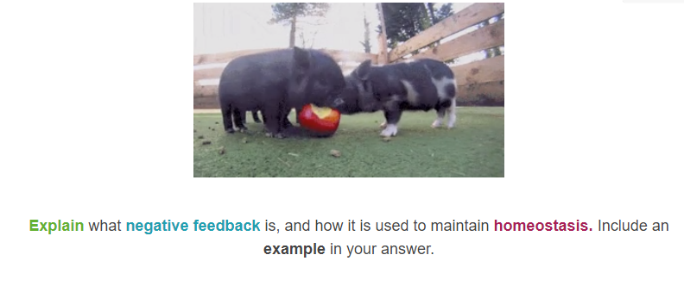

Slide 14
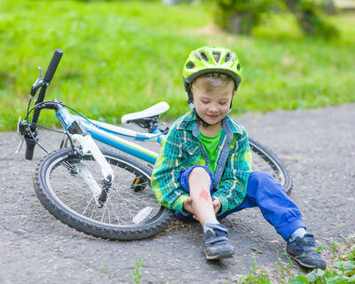
Now let's learn about the other type of feedback the stimulus-response model can use: positive feedback.

Slide 15
Remember, in the stimulus-response model, the body responds to a change in its environment.
This change is called a stimulus.

Slide 16
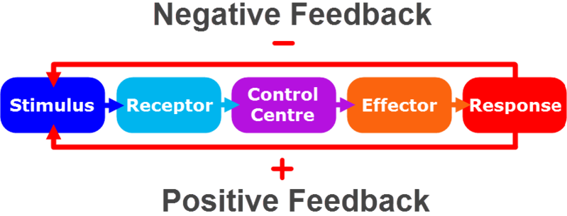
In negative feedback, the body's response acts against the stimulus.
This keeps the internal environment stable.
However, positive feedback is the opposite! In positive feedback, the body amplifies the stimulus. This encourages change in the internal environment.

Slide 17
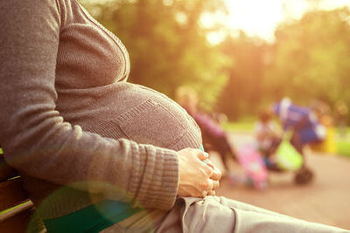
A classic example of positive feedback is childbirth.
When a woman goes into labour, the brain produces a hormone called oxytocin. This hormone causes the uterus to contract, which pushes the baby through the birth canal.

Slide 18
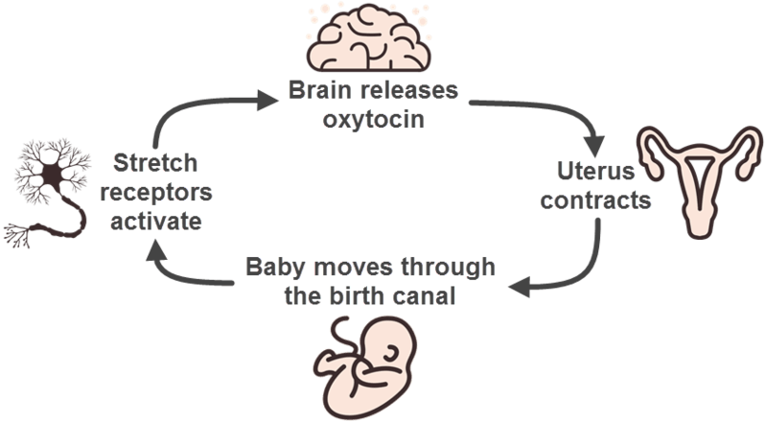
As the baby travels through the birth canal, it activates stretch receptors.
This starts a cycle.
The stretch receptors signal to the brain to produce more oxytocin. The increased concentration of oxytocin causes the uterus to contract even more. The contractions push the baby along, which activates more stretch receptors and promotes the release of more oxytocin.

Slide 19
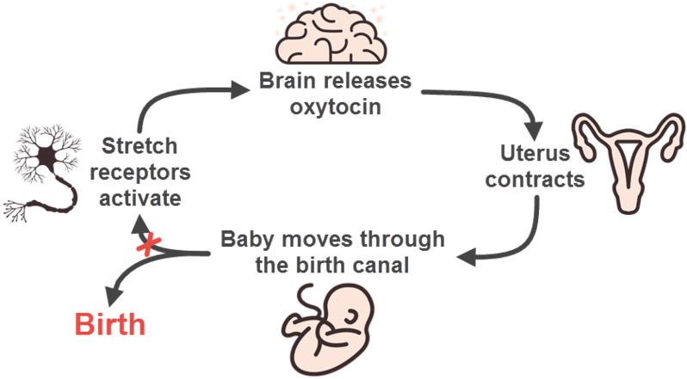
The cycle ends when the baby is born and can no longer activate stretch receptors in the birth canal.
With no stretch receptors being activated, the brain stops producing oxytocin, and the uterus stops contracting.

Slide 20
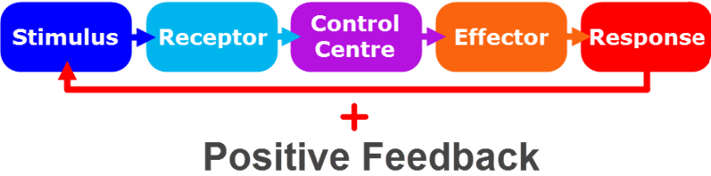
In this example, the stimulus was the baby stretching out the birth canal as it passed through.
The response was to increase contractions of the uterus, so as to push the baby through the birth canal faster.
See how the response amplifies the stimulus? That is why this is an example of positive feedback.

Slide 22
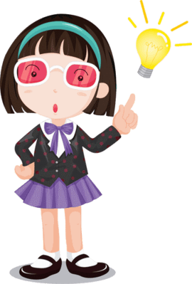
An important concept to understand is that positive feedback is not a part of homeostasis.
This is because homeostasis is all about keeping the internal environment stable by opposing change. In comparison, positive feedback encourages change!

Slide 23
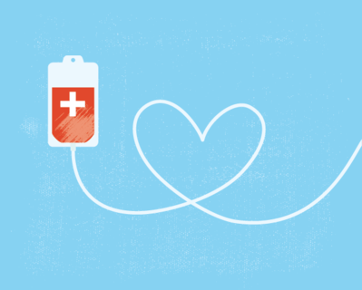
That doesn't mean positive feedback isn't useful though.
In childbirth, it helps the baby be born faster. Positive feedback is also used to promote lactation when a child is breastfeeding, and to promote blood clotting when you are injured.

Slide 24
Let's quickly review what we know about positive feedback.
In positive feedback, the body's response amplifies the stimulus. This promotes change in the internal environment.
This makes positive feedback unsuitable for homeostasis, which is all about preventing change.
However, it is useful for other things, such as childbirth and blood clotting.

Slide 25
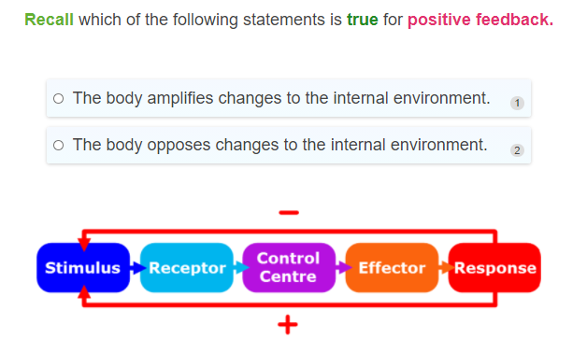

Slide 26
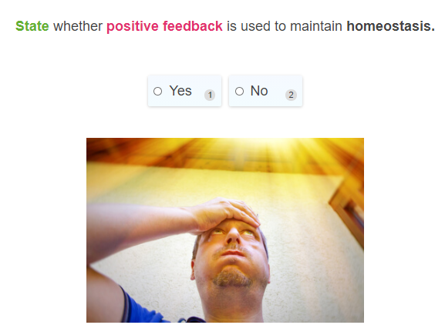

Slide 27
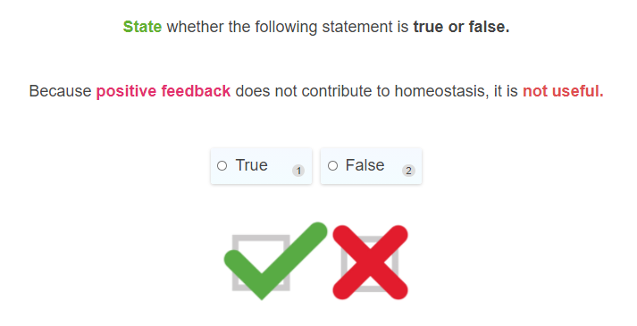

Slide 28
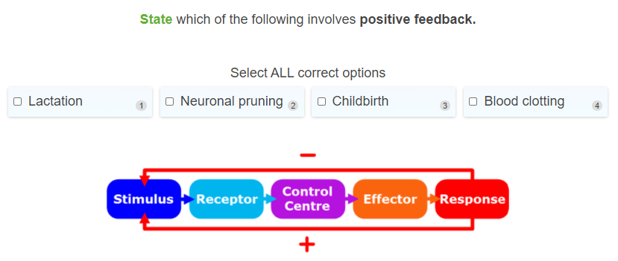

Slide 29
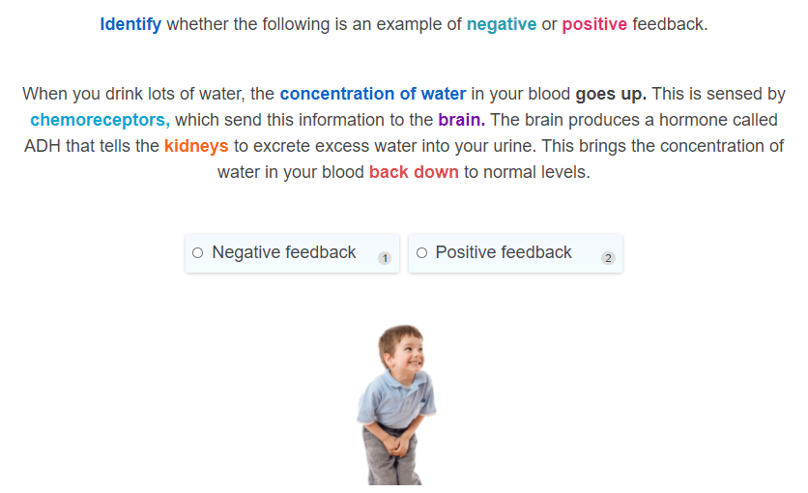

Slide 30
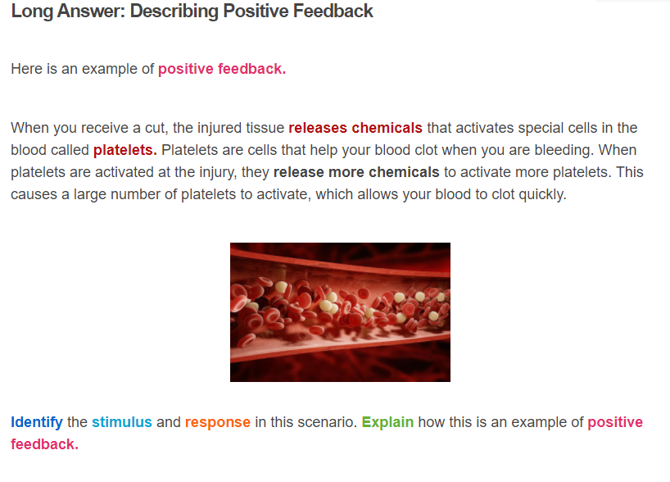

Slide 31
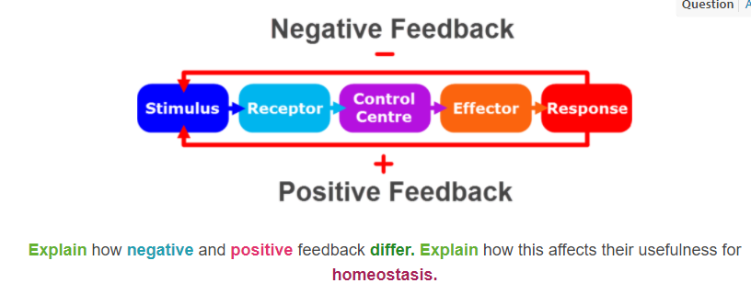

Slide 32
